Slide 1
Help Desk Overview
Included Support
Maverick Gardner’s Help Desk is designed to provide you with professional and courteous customer service, expert problem resolution and unparalleled peace of mind.
With Maverick Gardner’s Help Desk, your employees can enjoy peace of mind knowing that our certified technicians can quickly and efficiently resolve even the most complex technical problems.
Microsoft and Apple Desktop OS
Microsoft Office
Email Applications and Web Browsers
Thin Clients and VDI
Hardware and Network Troubleshooting
Printer Installation and Support
Mobile phones and Tablets
User Administration
File or Folder Permissions
Password Resets
Desktop Performance Problems
Virus and Malware Infections
And More!

Slide 2
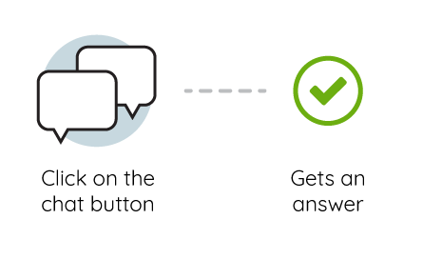
Contacting the Help Desk
Contact the Help Desk via Chat
The Help Desk can be contacted via the chat tool on your desktop or menu bar.
Contact the Help Desk via Phone
Our technicians can be reached via phone at 647-484-6045 extension 2
Contact the Help Desk via Email
Technicians can also be contacted via email: mgithelpdesk@maverickgardner.com

Slide 3
How to Use Help Desk Chat

Slide 4
Why Chat?
SIMPLE • EFFECTIVE • TIMELY
92%
73%
79%
customers are satisfied using live chat services compared to other modes of communication
customers are satisfied after using live chat
respondents in a survey said they preferred live chat because they received answers quickly
Source
Source
Source
Notes:
Chat is a simple and effective way to provide an instant and timely assistance to customers, which creates a convenient, two-way form of communication that results in a higher level of customer satisfaction. Once you consider the recent stats surrounding Help Desk chat, it becomes clear why this is an imperative feature to implement:
92% customers are satisfied using live chat services compared to other modes of communication. (Source)
73% of customers are satisfied after using live chat—that’s higher than any other medium of customer support such as email, telephone or social media. (source)
79% of respondents in a survey said they preferred live chat because they received answers quickly. (Source)
Why are satisfaction numbers so high? Chat is well-suited to cater to users in a modern work environment. It’s more convenient than telephone, which can be slow due to queues and can be disruptive in a quiet office setting. It’s faster than email, and a more immediate option as well. Additionally, users can multitask while using chat, preventing dips in productivity and time wasted on hold.
For MSPs specifically, sometimes technical issues are more easily written out carefully than spoken. Complex technical steps, links to additional resources, images and more can all be conveyed through chat, which amounts to faster resolve times, better first-contact resolution and overall higher customer satisfaction rates.

Slide 5
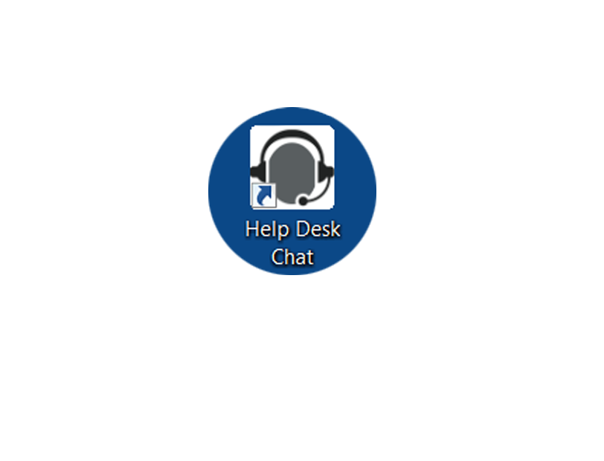
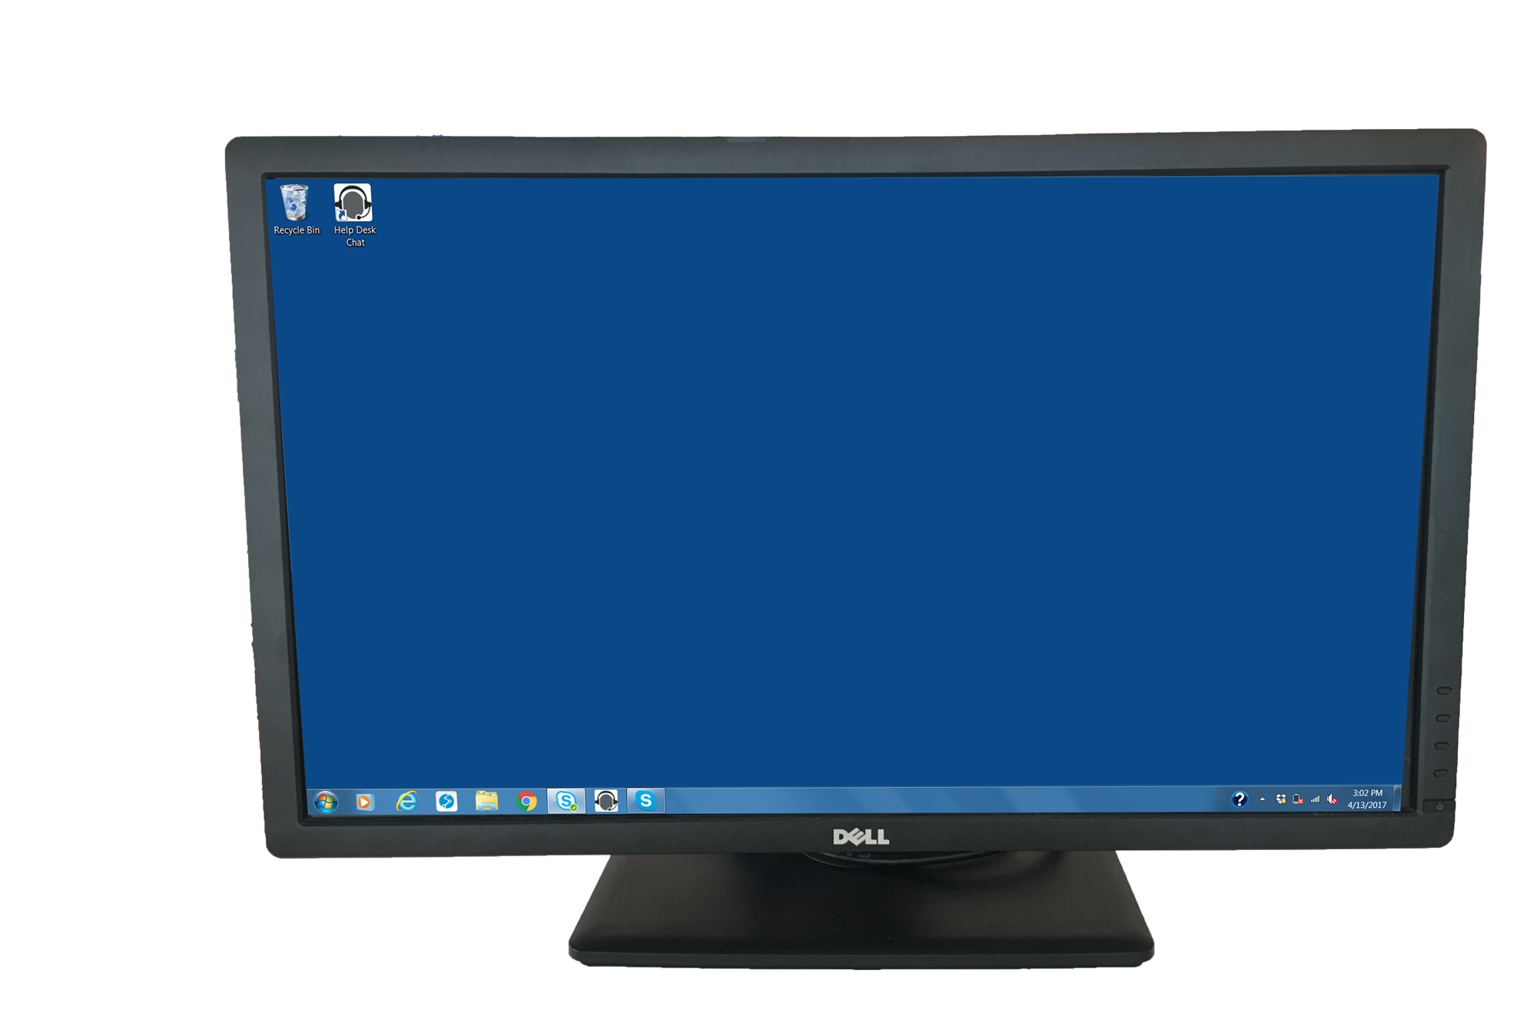
Launch Help Desk Chat Application
1.
Click Help Desk Chat shortcut on your desktop or menu bar to launch the application

Slide 6
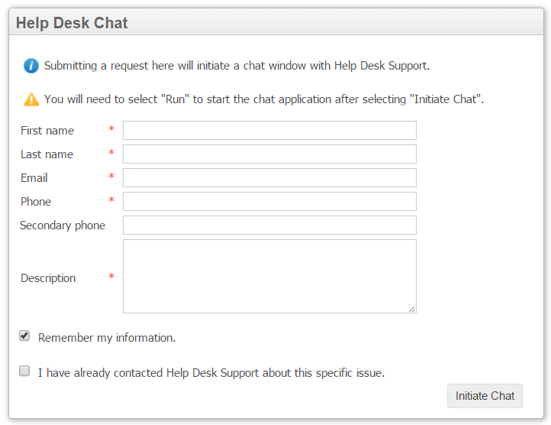
Complete Form to Initiate Chat
2.
Enter your contact information and a brief description your issue. Then click Initiate Chat to open a chat window.

Slide 7
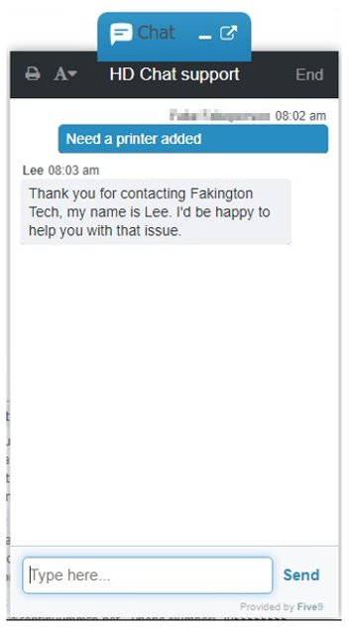
Start Live Chat!
3.
Begin typing to start your conversation with our Help Desk technician.

